Slide 1
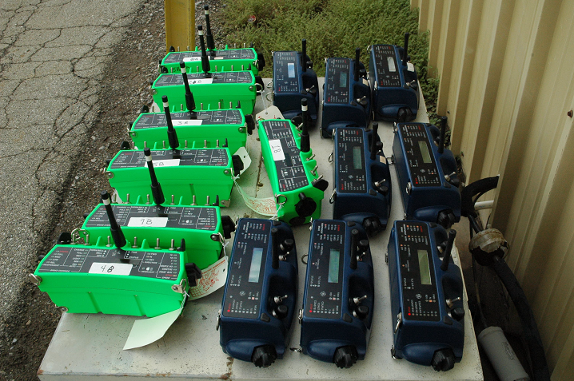
GE MDS RCL220
Tom Mayo
2013-06-25

Slide 2
History
Worked with Union Pacific to design and implement RCL communications system starting in 2002 (?)
AAR S-5904 standard adopted in September 2005
Worked with UPRR, GE Transportation and Cattron (and Canac/Beltpack personnel) to integrate, stabilize, and deploy in dozens of yards and yard clusters

Slide 3
GE MDS RCL220 Benefits
Direct/Infrastructure modes for robust radio communications
Repeater Communities can cover giant yards (e.g. North Platt, deployed this year)
Repeater/Locomotive components are identical for sparing
  Access Point (no radio)
  Packaged Radio Module (radio)
Basic Serial Protocol (BSP) for unit-to-unit addressing
  OCU to LCU, LCU to OCUA, OCUB, or BOTH
Scrambling protection against stale OCUs
  Keys established at IR link time to protect session
CRC16 for end-to-end message integrity
OCU radio firmware upgrade over the air
Rich test modes and management capabilities
US Patent 8,050,809

Slide 4
GE MDS RCL220 Benefits
OCU radios derive timing from the LCU radio to coordinate their messaging with each other.
The GE MDS RCL220 system is completely application-aware so that the OCU/LCU link is maintained throughout all mode transitions.
The LCU radio is the only unit that decides what infrastructure to be under, so there is no chance that the OCUs and LCU will be under different isolated repeaters.
US Patent 8,050,809

Slide 5
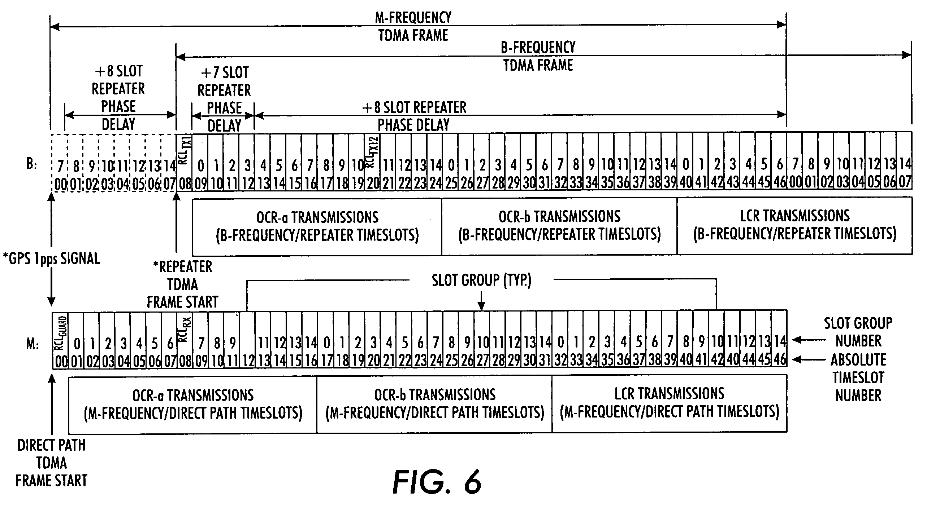
TDMA Scheme
US Patent 8,050,809

Slide 6
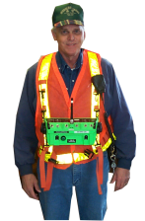
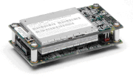
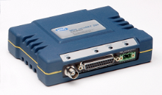
Direct Mode
Each unit sends 2 copies of each message per second, giving 2 chances for reception.
15 Systems can coexist (proven extensively on UPRR property)
LCU and OCU Messages
OCUA
LCU
2 chances to hear each message
OCUB
US Patent 8,050,809

Slide 7
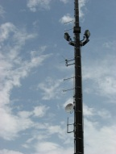

Infrastructure Mode - Island
Each unit sends 1 copy of each message.
Repeater sends superior copy of each message from high vantage point.
15 Systems can coexist (proven extensively on UPRR property)
OCU Messages
LCU Messages
Repeater
Repeater
OCUA
OCUA
LCU
LCU
2 chances to hear each message
2 chances to hear each message
OCUB
OCUB
US Patent 8,050,809

Slide 8
Infrastructure Mode - Islands
Island Repeaters
Configured Geo Zone for Repeater 3
Configured Geo Zone for Repeater 1
Coverage Area for Island Repeater 1
Coverage Area for Island Repeater 3
Coverage Area for Island Repeater 2
Configured Geo Zone for Repeater 2
Locomotive passes in and out of pre-defined coverage zones seamlessly.
Hand-off is make-before-break.
US Patent 8,050,809

Slide 9
Infrastructure Mode - Communities
Each unit sends 1 copy of each message.
ANY Repeater can hear the message.
Repeaters share all received messages.
Message is retransmitted by the best repeater for the destination.
Destination can hear messages even when there is NO direct path.
Repeater
Repeater
Repeater
Backhaul
Backhaul
LCU
OCUA
OCUB
2 chances to hear each message
OCU Messages
US Patent 8,050,809

Slide 10
Infrastructure Mode - Communities
Configured Geo Zone for Repeater Community
Coverage Area for Infrastructure
Repeater 1
Coverage Area for Infrastructure
Repeater 3
Coverage Area for Infrastructure
Repeater 2
Infrastructure/backhaul repeaters form a community.
Messages are transmitted by the best repeater for each unit.
US Patent 8,050,809

Slide 11
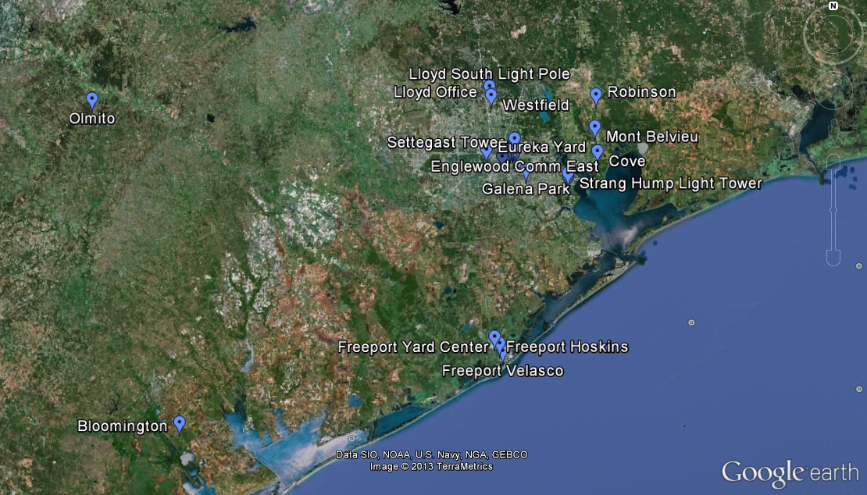
Example – UPRR Houston Area Yards

Slide 12
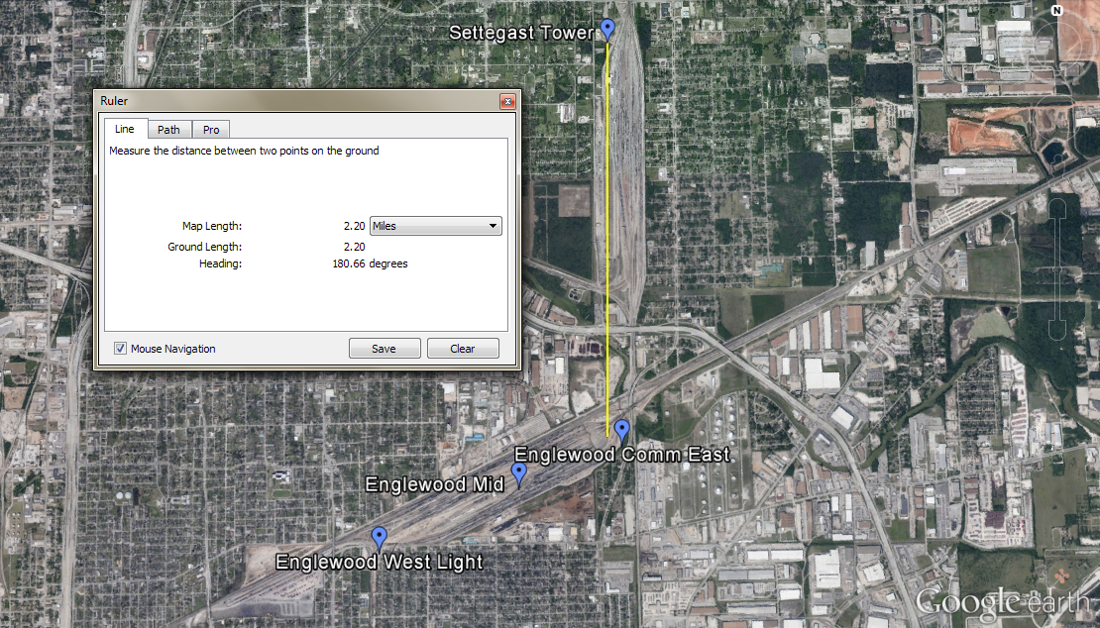
Example – UPRR Houston Area Yards

Slide 13
Benefit of Repeated Transmissions
For Direct Mode:
Consider a case where LCU to OCU or OCU to LCU messages succeed 80% of the time.
With just one repeat of that message, the chance of success increases to 96% (1-(1-0.8)²).
If we start instead with 90% success, just one repeat increases success to 99% (1-(1-0.9)²).
For Infrastructure Mode:
Say direct success is 90% and repeater success is 99%.
The resultant success is (1-(1-0.9)*(1-0.99)) = 99.9%.
The net effect of this is to extend range on the order of 50 to 100%.
US Patent 8,050,809

Slide 14
Summary
Patented MAC provides very robust communications
  With two chances to receive each message in Direct Mode, GE MDS RCL220 outperforms other schemes.
  With Island Infrastructure, this is enhanced even further by the repeater’s high vantage point.
  With unique Repeater Communities, there is even more enhancement to cover large yards.
GE MDS has 10 years experience with RCL with UPRR and the major RCL integrators

